Slide 1

Term Project Presentation Overview
DSC630-T301
By: Mithil Patel, Gabriel Avinaz, and Joshua Greenert
Notes:
Welcome to our Team Project Presentation Overview. This will be a presentation over the process, methods, and conclusion of the project that Gabriel Avinaz, Mithil Patel, and myself (Joshua Greenert) concluded.

Slide 2

Problem Statement
To enhance users' shopping experience and help them make correct purchases, Steam Technologies LLC wanted to develop a gaming recommendation system. Not only will it increase sales, but it would assist in developing the company's credibility for consumers' gaming needs
Notes:
To enhance users' shopping experience and help them make correct purchases, Steam Technologies LLC wanted to develop a gaming recommendation system. Not only will it increase sales, but it would assist in developing the company's credibility for consumers' gaming needs. The need for a recommendation system only becomes more relevant after seeing such a market share held by other gaming platforms, and how often users are playing the games that they offer through their respective service. In fact, the revenue from the gaming industry is projected to be around 365.6 billion dollars for 2023 alone (Statista, 2022)! Therefore, the competitor within the gaming industry that builds a model that can predict what games users would want to play — after users play other games — would lead by the example that other companies would follow.

Slide 3


Data Collection
Notes:
All of our data used throughout this project were obtained through Kaggle.com from users uploading data collected through Steam Technologies LLC. Kaggle is a brilliant source for datasets, especially for budding data scientists. Other sources used for validating information and claims in the gaming industry can be found on the references section of our presentation. The data, specifically obtained from Kaggle, contains Steam user reviews where users have reviewed games they’ve played or purchased to encourage — or discourage — others from purchasing the game, and a secondary dataset of Steam games on the platform with short descriptions about the games themselves. Both datasets were selected because of their massive size and relevance to the upcoming project. They are useful in solving the problem that we have because the sheer size of the data allows us to feed machine learning models easily to build predictions based on what all is encompassed.

Slide 4
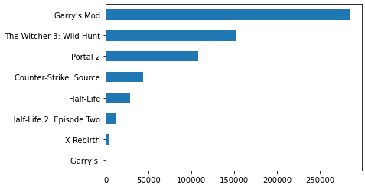
Visualizations
Notes:
When we first started this project, we explored the data by graphing what we could see. We wanted to grasp a better understanding of what data we had, and how we could use this data to tell a story. From the graph shown, we could quickly see that some games had excessively more reviews than others. Was this because of the playability? Was this a result of fandom on another level where users only rated games based on ones that others were rating? Being gamers ourselves, it was easy to identify why the sample we grabbed showed a massive amount of support since the games listed with the most reviews were typically providing a lower skill gap, were more enjoyable to play than most other games, and substantial functionality that would ensure an enjoyable experience overall. However, that wouldn’t be as transparent to the layman.

Slide 5
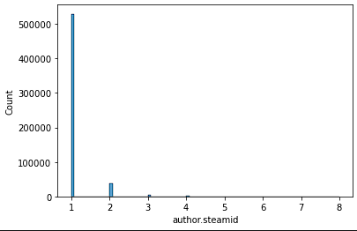
Visualizations
Notes:
Next, we wanted to better understand who our author’s of this data were. We created a graph of steamids — or users — and the amount of reviews they left on games. As you can see from the graph, the data is predominantly one, then descends rapidly to 2, but almost disappears for 3 and 4 and so on. From this information, we could tell that users typically reviewed 1 to 2 games, but rarely reviewed more than 2. While this seems like a consistent expectation from gamers, this concerned us initially as the data may project a bias when only 1 user has 1 review. Likewise, we were concerned over whether the model would make accurate predictions if each user only has one review.

Slide 6

Exploring The Data
What did you find out by exploring the data?
The initial dataset only contained review information for 315 games
Review dataset contains recommendations from over 21 million users
Second data set contained 55,000 game descriptions
Reviews by Steam were overwhelmingly bias towards positive recommendations
Games with larger review counts correlate with a higher ratio of positive reviews
Majority of user text reviews presented unsuitable data for our content-based approach
Notes:
Gabe
Our initial data set contained a collection of 21 million reviews and recommendation across a selection of 315 games.
We found that of the games reviewed, the vast majority of games presented an overwhelming bias towards positive reviews. This means users are way more likely to review a game that they would personally recommend.
Additionally, we found that a games popularity also shows some correlation with a higher ratio of recommendations to total reviews.
We found that following our data preparation process, many of the text reviews for games provided and unsuitable data set for one of our models and incorporated a second data set to create a competing model
Our supplementary dataset contains about 55,000 descriptions for games available on Steam.

Slide 7
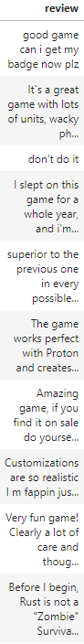
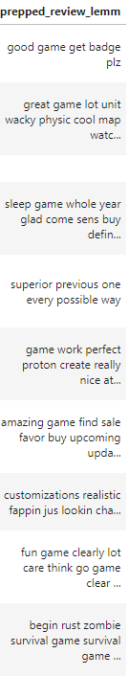
Data Preparation
What steps did you perform to prepare the data?
One-Hot Encoding of categorical data
Game description and review entries prepared for vectorization
Adjusting case, contractions, and non-alphabetical characters
Tokenization
Stop-Words
Lemmatization
Adjustments for NAN values in numerical data
Notes:
Gabe
Our data preparation process begins with a One-Hot encoding of each of our categorical entries. Doing this we can create more options for ML models to utilize each feature.
Our game description and text review were processed with a number of preparations steps in order to ensure the best accuracy.
This began with the removal of differences cases, and characters for each entry, and the adjustment of any contractions.
The entries were then tokenized, or split into separate words, so we could drop commonly used words using a Stop-Words like from the Natural Language Toolkit.
Words were then lemmatized, a process in which the inflection of word endings are removed returning them to the base word.
Entries that no longer contained usable descriptions or reviews were then removed from the data set to improve performance.

Slide 8
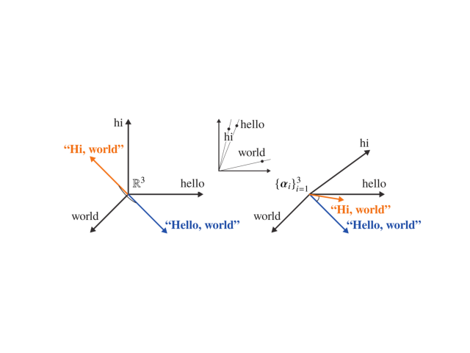
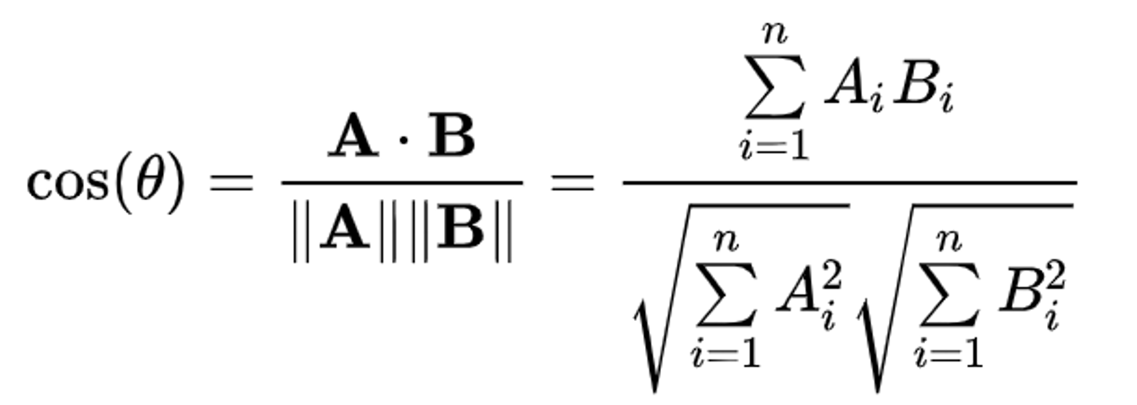

Models & Metrics
What type of modeling are you using on your data?
Unsupervised Models:
Collaborative model uses a Nearest Neighbor (NN)
Content-based model uses Term Frequency-Inverse Document Frequency (TF-IDF) Vectorization
What metric(s) are you using to measure your results?
Used the cosine distance similarity between entries to measure the game’s closeness
Notes:
Once we had our final dataset prepared for building our model, we decided to utilize two different types of recommendation systems: a Collaborative filtering system and a content-based system. The collaborative filtering system uses unsupervised Nearest Neighbor (NN), which essentially identifies similar instances within the dataset and groups them together into clusters. The content-based filtering system uses unsupervised Term Frequency-Inverse Document Frequency Vectorization or (TF-IDF). TF-IDF vectorization identifies important words in a document by assigning them a weight based on frequency of occurrences. To measure our results, we decided to use cosine distance, which uses cosine of the angle between the two vectors to find similarity between two vectors. As shown in image here,

Slide 9
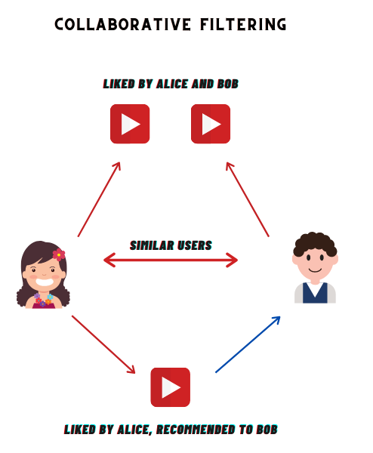
Model Option 1:
Collaborative Filtering
Matrix of Steam users and games with marked recommended games for each user
Utilizes a Compressed Sparse Row (CSR) matrix to alleviate efficiency concerns
Unsupervised SciKit-Learn model Unsupervised Nearest Neighbors to find best matches
n_neighbors: The number of recommendations to make based on the input game
algorithm: uses brute-force algorithm because of CSR Matrix.
Reaches and efficiency of O(NP)
metrics: cosine distance used as metric to measure the closest neighbor results
Notes:
Gabe
The first model we implemented used a collaborative filtering method for creating recommendations.
This model utilizes a matrix consisting of our encoded user recommendation or rating, for each game.
The dimensions of the matrix would be equal to the total number of games times users (315 X 55 Million) so to alleviate memory and make the full data set manageable we utilized a more efficient storage method in the compressed sparse row matrix.
To get the desired output from our model, Unsupervised Nearest Neighbor, we decided on a number of parameters:
The N neighbors attribute is the number of recommendations that our model will create.
Our algorithm setting is set to brute-force by default for CSR Matrices and provides an efficiency approaching O of N times P.
Metrics for this model follow our cosine similarity approach. This model returns as a cosine distance. The closer to 1 the value is, the closer the similarity

Slide 10
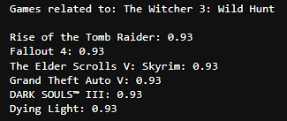
Example Data From Model 1
Notes:
From our collaborative filtering model, we ran through several iterations of testing. One of the test samples are provided here where you can see we selected the game “The Witcher 3: Wild Hunt”. If you’re familiar with this game, then you know that it’s a 3d open world role-play style game where you, as the Witcher, explore and defeat various monsters while assisting civilians with various side quests. From the list below we had similar results where every game, for the most part, cover all of these aspects to the gameplay. When we printed these out from our results, we also printed the accuracy score to see how close we were. As you can see, the results were approximately 93% for each game listed from the top of the recommendations which matches our expectation based on the results.

Slide 11
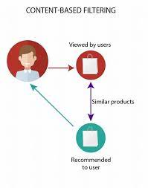
Model Option 2:
Content-Based Filtering
Used Term Frequency-Inverse Document Frequency (TF-IDF) Vectorizer to create sparse matrix of game descriptions
Utilizes Cosine_Similarity from Scikit-Learn to return metrics on each description in the matrix
Cosine similarity measured for every entry in the matrix, passed as both targets and features
Notes:
Gabe
Similar to the collaborative model, our content-based model creates a matrix of entries that then measure for its similarity.
The description of each game is fit to a Term Frequency-Inverse Document Frequency Vectorizer that creates a matrix of word counts across all descriptions that can be used to measure similarities between other descriptions.
Scikit_Learn’s Cosine similarity function is used to measure the vectorized matrix, and returns a matrix with each game-similarity measured as a cosine.

Slide 12
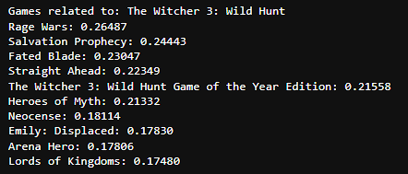
Example Data From Model 2
Notes:
Like our previous model, we created several sample tests to ensure we were getting the data we expected. The content-based filtering model provided an entirely different set of games for our user with much lower accuracy scores for the predictions. Surprisingly though, one of the predictions managed to predict a different version of the same game. However, the rest of the recommendations were much further off and almost incomparable to the game that we used for a baseline.

Slide 13

Ethical Considerations
What do you need to consider ethically regarding the data, your model and the presentation of results?
Popular games get more reviews due to familiarity
Companies can pay users to post fake reviews
What ethical implications exist, or could exist if this project were live in production?
Social effect: insulating users from exposure to different genre
What could be done to mitigate the ethical concerns, if anything?
Large dataset offset for bias and mitigate impact of fake reviews
Add a filtering system to ensure age-appropriate rating
Notes:
Now that we have our model ready, there are several ethical considerations to bear in mind. For instance, there is a question about bias since popular games have more reviews, which can gain more attention to place it toward the top of the list. Additionally, there is the concern that game companies can hire or pay bad actors to write fake reviews to promote their games which can bias our recommendation. However, these issues can be covered with a larger dataset to compensate for biases in our recommendation system. Additionally, we also need to consider how the recommendations can insulate users from exposure to a different genre. For example, if a user only gets recommended violent games, we must consider how that will shape their perception of reality. To combat this issue, we decided to enable providing one random match along with the top recommendations while using age-appropriate ratings to avoid recommending R-rated games to younger users.

Slide 14
Conclusion
What recommendations would you make based off your analysis?
The KNN model (collaborative filtering)
Is your model ready for deployment?
The model is ready for deployment, but we can improve it
What work still needs to be done?
Building web user interface (scope beyond the course)
Add filter for age restrictions
Notes:
In essence, we decided to use unsupervised Nearest Neighbor as our primary model to develop our recommendation system. Our recommendation system is ready for deployment; however, there is always room for improvement. We need to build a web user interface for the website to make it easier for users to interact with systems to generate game recommendations. Additionally, we need to include age restrictions when generating recommendations for both models, while including Tags and Genre descriptions into the TF-IDF vectorization model to improve similarity metrics.

Slide 15
Results
What did you learn?
Massive data presents severe processing challenges
Results for collaborative and content-based filters present different types of similarities between games
Collaborative models find similar interest between users
Content-based models find similarities in games
Subject Matter Experts (SMEs) are crucial for verification of key results
Notes:
As for the results, teams usually like to reflect on what they’ve learned from the processes that were taken. From this project, we can speak to several points. First, dealing with massive datasets poses many challenges throughout the process. Lemmatization with a massive dataset took our model nearly 6 hours to run the code. As you can see, we encountered challenges and were lucky enough get through them to deliver before the deadline; however, it’s a significant concern for future iterations of similar deployments. Moreover, we learned that different models provide differing results. The difference in result may not be very significant at first, but could become an issue later on with additional agile sprints performed. As we dove deeper into the project, we realized that domain knowledge was essential for our analysis; since we were all gamers, we were able to understand when one model was providing bad results over another. One thing to note here is that model accuracy in the context listed above is reflective of subject matter experts (SME) that were able to review the games from the list while having some familiarity with them and whether they were comparable to other games displayed. Therefore, having prior knowledge vital for verifying results.

Slide 16
Questions?

Slide 17
References
M., M. (2021) Steam reviews dataset 2021, Kaggle. Available at: https://www.kaggle.com/datasets/najzeko/steam-reviews-2021?select=steam_reviews.csv(Accessed: December 10, 2022)
Milano, Silvia, et al. “Recommender Systems and Their Ethical Challenges - Ai & Society.” SpringerLink, Springer London, 27 Feb. 2020, https://link.springer.com/article/10.1007/s00146-020-00950-y
Statista. (2022, February 9). Video games - worldwide. Retrieved February 14, 2023, from https://www.statista.com/outlook/dmo/digital-media/video-games/worldwide#:~:text=The%20largest%20segment%20is%20Mobile,to%20US%24137.80%20in%202023.
Tristan. “All 55,000 Games on Steam (November 2022).” Www.kaggle.com, www.kaggle.com/datasets/tristan581/all-55000-games-on-steam-november-2022

